Slide 1
Machine Learning for Public Policy
Rayid Ghani

Slide 2
Goals of the course
Understand the entire Machine Learning Process
Know how ML methods work
Learn how to use them
Build Reusable ML Pipelines
Solve Policy problems using Machine Learning

Slide 3
Pre-requisites
Computational Skills
Proficiency in Linux (cmd line), Python programming, Python for data analysis (at least pandas and matplotlib)
Data Skills
Dealing with data in text files and databases (SQL)
Math & Statistics Skills
Probability & Stats
Discrete Math
Linear Algebra

Slide 4
How is this course different?
Traditional ML Course
95% Methods
5% Evaluation methodology
This Course
50% Methods
10% Evaluation Methodology
10% Problem Formulation
10% Ethics, Trust, Interpretability
10% Building a ML System
10% Feature Development

Slide 5
Implications
Assumptions behind the methods
Theory
Algorithm
Implement (code them from scratch)
Parameters
Use them
Extend/Modify them

Slide 6
Logistics
TAs
Labs
Office hours
Assignments
Weekly Reviews (due before class every Tuesday)
Programming Assignments
Mid-Term (extended take-home assignment)
Project (proposal, presentation, progress report, final report, presentation)
Attendance (is not optional)

Slide 7
Recommended Books
Data Science for Business by Provost and Fawcett
Good practical introduction to ML
Machine Learning by Peter Flach
Good introduction to algorithms/models/methods

Slide 8
Online Resources
Introduction to Statistical Learning
Book: http://www-bcf.usc.edu/~gareth/ISL/
Videos:https://www.youtube.com/user/dataschool/playlists?shelf_id=4&sort=dd&view=50
Mining Massive Datasets
http://www.mmds.org/
Good set of videos on ML: https://classroom.udacity.com/courses/ud262

Slide 9
How does ML fit in with other data analysis methods?
Computer Science
Statistics
Social Sciences

Slide 10
What do you need to learn?
Skills
Computer Science & Programming
Statistics
Social Sciences
Experimental Design
Communication
Problem Formulation
Ethics & Legal Issues

Slide 11
Machine Learning
“A computer program is said to learn from experience E with respect to some task T and some performance measure P, if its performance on T, as measured by P, improves with experience E.”

Slide 12

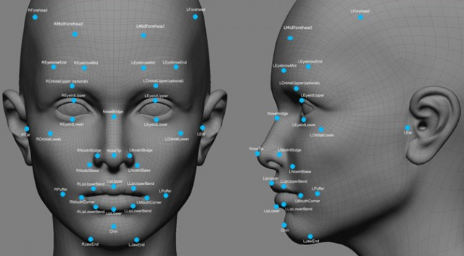

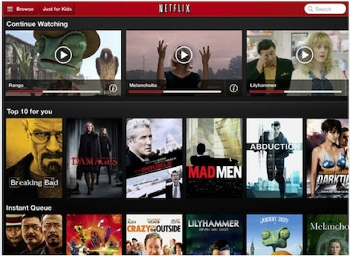
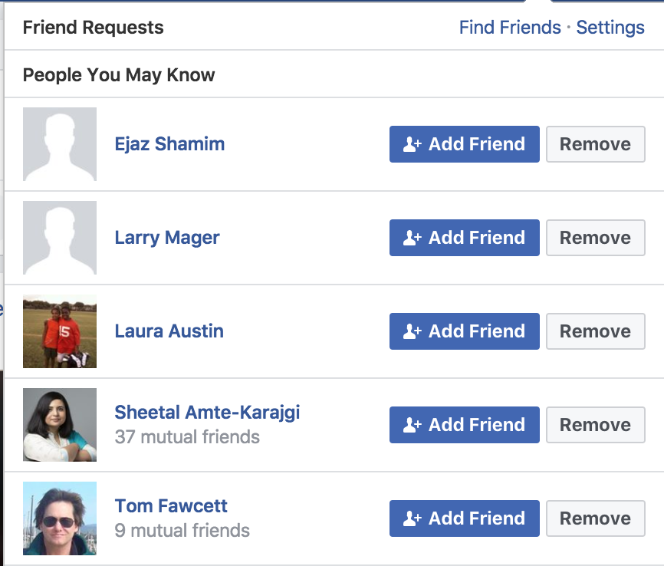
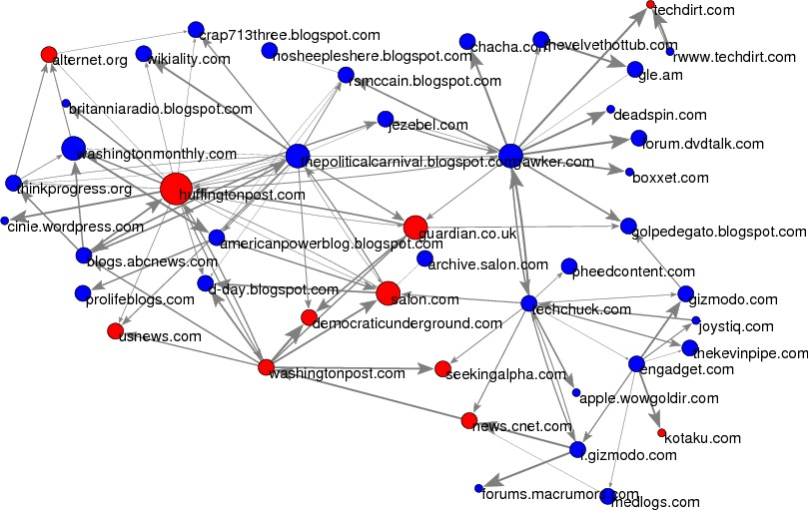
Notes:
Usps
Amazon/netflix - recommender
Advertising
Health
Autonomous cars

Slide 13
Why Machine Learning?
Goal: Adaptive and Scalable systems that are Cost-Effective to build and maintain
Rules-based systems are rigid and expensive
Lots of data is available to “train” the system

Slide 14
Machine Learning Benefits
The only way to solve problems
Magic
Data-Agnostic
Notes:
Needs to be combined with other methods
Features are important. The expert still needs to do work in defining the problem, generating features, selecting models, evaluation criteria
Without good data, models are bad. Bias, size, etc.

Slide 15
Machine Learning Benefits
The only way to solve problems
Magic
Data-Agnostic
Notes:
Needs to be combined with other methods
Features are important. The expert still needs to do work in defining the problem, generating features, selecting models, evaluation criteria
Without good data, models are bad. Bias, size, etc.

Slide 16
Types of ML tasks for Policy Problems
Description (Understand the past)
Detection (Anomalies, Events, Patterns)
Prediction (Predict the Future)
Behavior Change (Causal Inference)

Slide 17
Different aspects of the class
Lectures
Readings
Labs
Programming Assignments – build ML pipeline
Project – solve end to end problem using your pipeline
Mid-term – test understanding of concepts learned in class

Slide 18
Programming Assignment

